Slide 1

类器官研究领域快速崛起的“基石”：细胞因子
李田子, Ph.D.
高级产品经理
北京义翘神州科技股份有限公司
05-2024
义翘神州

Slide 2

CONTENT
1
类器官与细胞因子
2
类器官培养的关键细胞因子“配方”
3
经类器官培养验证的细胞因子
义翘神州

Slide 3
01
类器官与细胞因子
义翘神州

Slide 4
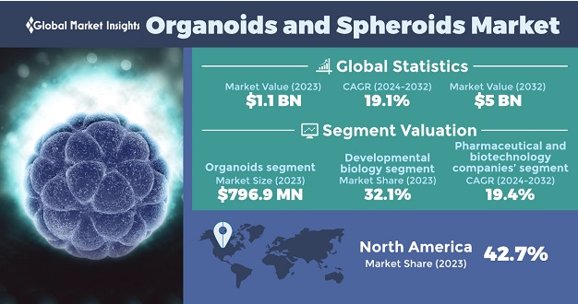
类器官研究-市场情况
In 2023，The global organoids and spheroids market size was estimated at USD 1.1 billion
CAGR (2024-2032): 19.1%
By End-Use
Biotchenology & Pharmaceutical industries
Academic & Research institutes
Hospitals & Diagnostic Centers
Source: www.gminsights.com
义翘神州

Slide 5
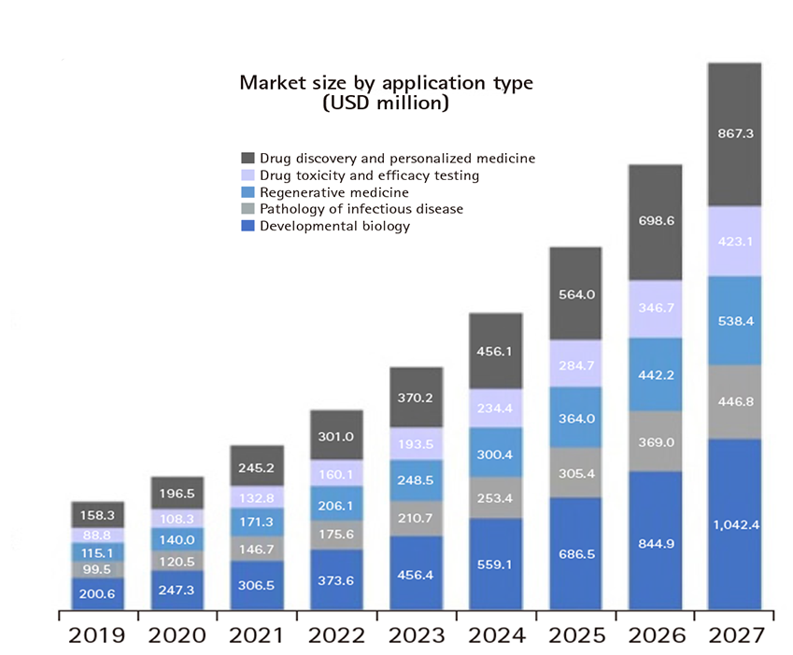
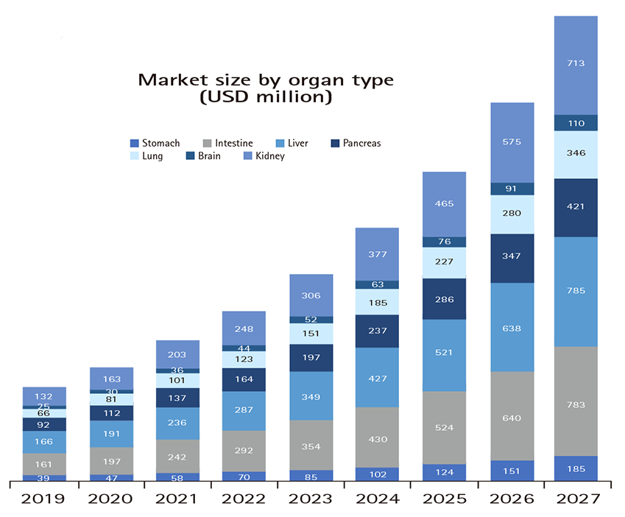
类器官研究-市场情况
√
√
√
√
√
Hanbyeol Lee; et al. doi.org/10.51335/organoid.2021.1.e11.
义翘神州

Slide 6
类器官研究-研究进展
Region Name | Studies #
World | 223
Europe | 95
North America | 50
East Asia | 53
… | …
Conditions by Alphabetical | Studies #
Digestive System Diseases | 90
Carcinoma | 61
Endocrine System Diseases | 35
Urogenital Diseases | 32
Breast Neoplasms | 31
… | …
Paper：NCBI-PubMed Central
Clinicaltrials：Organoid-223 studies
Source: https://ClinicalTrials.gov Until 05/06/2024
义翘神州

Slide 7
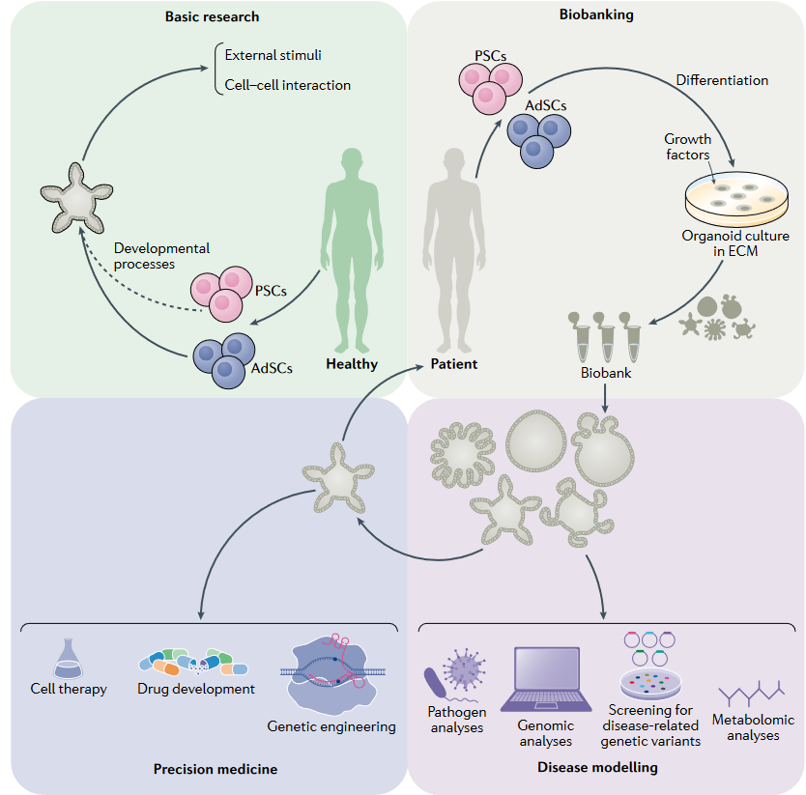
类器官研究-潜在应用
Basic research
- Cell-to-cell interactions
Mechanisms of stem cell homeostasis
Biobanking
Precision medicine
- Response to drugs
- Resources for regenerative medicine coupled with genetic engineering
Disease modeling
- Mechanisms of human diseases
- Inheritable genetic disorders
Drug-screening analyses
Figure. Potential applications of human organoids
Jihoon Kim; et al. doi.org/10.1038/s41580-020-0259-3.
义翘神州
Notes:
biobanking, whereby samples obtained from patients can be used to generate patient-derived organoids and stored as a resource for future research;
生物银行，从患者身上获得的样本可用于生成患者来源的类器官，并作为未来研究的资源进行存储；

Slide 8
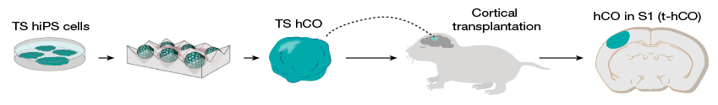
类器官研究-疾病模型
2024年4月24日, Nature刊发了一篇类关于脑器官相关的研究文章
Timothy综合征：自闭症、神经系统问题的遗传性疾病，由CACNA1C基因突变引起。
在小鼠模型中，相关突变并不总是能引起与人类疾病相同的症状。
类器官解决这一难题。
hiPS分化建立hCO，移植到搭上发育皮层，与其大脑整合。
干细胞（hiPS）：从Timothy综合征的患者提取获得
hCO：human cortical organoids
Xiaoyu Chen; et al. doi.org/10.1038/s41586-024-07310-6
义翘神州

Slide 9
肠道类器官-疾病模型
三种研究诺如病毒感染的肠道类器官模型
缺少可耐受的小动物模型
缺少可用于繁殖这种RNA病毒的的体外细胞培养系统等问题
作者 | 感染模型 | 干细胞来源
Ettayebi et al. (2016) | HIEs generated from stem cells of human intestinal crypts | Stem cells isolated from intestinal crypts in human intestinal tissues
Zhang et al. (2017) | HIOs develped from human PSC | PSC line WA01(non-secretor) and WA09(secretor)
Sato et al. (2017) | IECs deveped from human iPSC | Human iPSC line
诺如病毒疫苗和治疗的研究
挑战
3D 肠道类器官
HIE: human intestinal enteroid IEC: Intestinal epithelial cells
HIO: human intestinal organoid
Je Hyoung Kim; et al. doi.org/10.4167/jbv.2020.50.3.168.
义翘神州
Notes:
Human noroviruses (HuNoVs) are the main causative viral agents in epidemic and endemic acute gastroenteritis worldwide. Despite their impact on the global economic and health burden, developing effective control measures to prevent and treat norovirus gastroenteritis remains a difficult problem to solve.
人类诺如病毒（HuNoV）是全球流行性和地方性急性胃肠炎的主要致病病毒。 尽管对全球经济和健康负担造成影响，但制定有效的控制措施来预防和治疗诺如病毒胃肠炎仍然是一个难以解决的问题。

Slide 10
肠道类器官-药物筛选
应用场景 | 疾病 | 研究题目 | 临床#
药物筛选 | 结直肠癌 | Prospective Observation on the Accuracy of in Vitro Screening of Colorectal Cancer Chemotherapy Drugs Based on Organoids-on a-chip | NCT04996355
 |  | The Culture of Advanced/Recurrent/Metastatic Colorectal Cancer Organoids and Drug Screening | NCT05304741
 |  | Patient-derived Organoids of RAS/RAF Wild-type Metastatic Right Colon Cancer to Test the Sensitivity and Clinical Consistency of Combined Treatment of Cetuximab. | NCT04906733
 |  | A Prospective Multicenter Randomized Controlled Trial of the Clinical Efficacy of Neoadjuvant Therapy Based on Organoids Drug Sensitivity Versus Empirical Neoadjuvant Therapy in the Treatment of Advanced Rectal Cancer | NCT05352165
Qinying Wang; et al. doi.org/10.1038/s41392-022-01194-6.
义翘神州

Slide 11
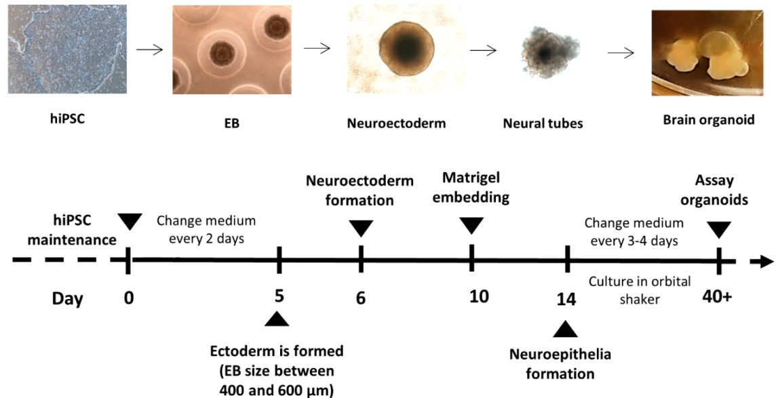
脑类器官培养过程
1. 扩增诱导多能干细胞(iPSC)
2. 放入的基质胶(Matrigel)使干细胞发育成脑类器官
3. 培养基中通常加入所需的细胞因子
脑类器官的培养过程
Ana Belén García-Delgado; et al. doi.org/10.3390/ani12223150.
义翘神州

Slide 12
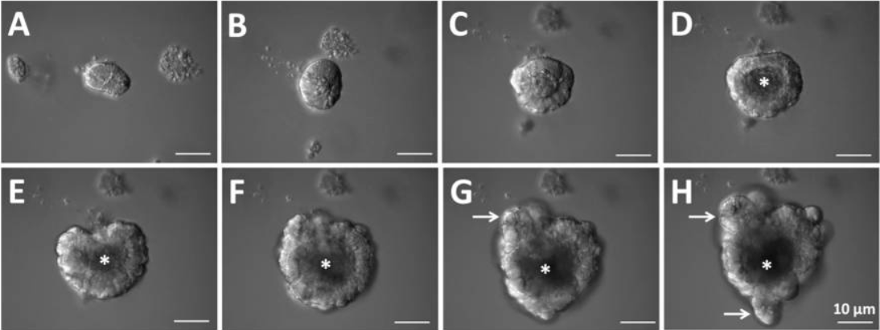
肠道类器官培养过程
1. 扩增小鼠小肠隐窝细胞，包埋在基质胶中
2. 培养基加入细胞因子：比如EGF、Noggin和RSPO1
类器官培养过程：(A–C)After the start of crypt culture, the upper opening rapidly become sealed. (D–F)Then, the lumen is filled with apoptotic cells. (G,H)The crypt region undergoes continuous budding events. (D–H)Asterisks indicate the lumen. (G,H)White arrows indicate crypt budding.
Toshio Takahashi; et al. doi.org/10.3390/ijms222010912.
义翘神州

Slide 13
02
类器官培养的关键细胞因子“配方”
义翘神州

Slide 14
脑类器官培养-主要细胞因子
生成血管
FGF2、Insulin
VEGF
小脑类器官
脑类器官
将多能细胞分化为神经外胚层谱系
EGF、Noggin
引导细胞沿特定器官谱系分化
中脑类器官
分化和成熟
BDNF、GDNF
Benjamin Galet; et al. doi.org/10.3389/fneur.2020.01005.
Praveen Joseph Susaimanickam; et al. doi.org/10.15283/ijsc22006.
Jay Gopalakrishnan. doi.org/10.1002/bies.201900011.
Guini Song; et al. doi.org/10.3389/fncel.2021.646921.
义翘神州

Slide 15
脑类器官-疾病模型
不同类型脑类器官 | 疾病模型/潜在应用
大脑/早期大脑类器官 | 遗传引起的小头畸形
 | 寨卡病毒引起的小头畸形
 | 米勒-迪克综合征*
中脑类器官 | 帕金森病潜在模型
下丘脑类器官 | 激素和代谢紊乱潜在模型
腺垂体类器官 | 垂体功能障碍的潜在模型
海马类器官 | 阿尔茨海默病引起的认知功能障碍的潜在模型
小脑类器官 | 脊髓小脑共济失调和丹迪-沃克综合征**的潜在模型
背侧端脑类器官 | 自闭症谱系障碍
前脑组合体 | 蒂莫西综合症***
*米勒-迪克综合征: 无脑回畸形为特征的病症
***蒂莫西综合症: 一种罕见的多系统遗传性疾病
**丹迪-沃克综合征: 小脑发育不正常
Jay Gopalakrishnan. doi.org/10.1002/bies.201900011.
义翘神州

Slide 16
脑类器官培养-主要细胞因子
不同类型脑类器官 | 培养所需试剂
小脑类器官 | SB431542, FGF2, FGF19, SDF1
背侧端脑类器官 | Noggin, FGF2, DKK1, EGF, ascorbic acid, BDNF, GDNF, cAMP
小脑板神经上皮 | FGF2,4,8, SAG, retinoic acid, BDNF, GDNF, NT3
中脑类器官 | SB-431542, Noggin, CHIR99021, SHH, FGF8, BDNF, GDNF and a cAMP pathway activator
腺垂体类器官 | DAPT, SAG, BIO, BMP4, dorsomorphin, Wnt4, Wnt5, FGF8, Nodal, iWP2
海马类器官 | Wnt inhibitor IWR1e, TGF-β inhibitor SB431542, 10% FBS, GSK3 inhibitor CHIR99021, BMP4
前脑类器官 | Dorsomorphin (BMP inhibitor), A83 (BMP and TGFβ inhibitor), SB-431542, WNT3A, CHIR99021 (GSK3β inhibitor), BDNF and GDNF
Elizabeth Di Lullo; et al. doi.org/10.1038/nrn.2017.107.
Jay Gopalakrishnan. doi.org/10.1002/bies.201900011.
义翘神州

Slide 17
肠道类器官培养-主要细胞因子
激活小肠隐窝的Wnt信号
隐窝数量增多
RSPO-1
Noggin
肠道类器官
EGF
Wnt
协助小肠增殖
维持肠道干细胞
Toshiro Sato; et al. doi.org/10.1053/j.gastro.2011.07.050.
义翘神州
Notes:
R-spondin-1 is a marker for intestinal stem cells。
Second, epidermal growth factor (EGF) signaling is associated with intestinal proliferation.¹³
Third, transgenic expression of Noggin induces expansion of crypt numbers.¹⁴
Fourth, isolated intestinal cells undergo anoikis outside the normal tissue context.¹⁵
Because laminin (α1 and α2) is enriched at the crypt base,¹⁶
we explored laminin-rich Matrigel to support intestinal epithelial growth.
Wnt:maintain intestinal stem cells

Slide 18
肠道类器官-不同种属培养试剂差异
种属 | 器官 | 干细胞培养条件
 |  | Basal culture medium | EGF | Noggin | RSPO-1 | Wnt3a | Nicotinamide | Gastrin | A-83-01 | SB202190
Mouse | Small intestine | √ | √ | √ | √
 | Colon | √ | √ | √ | √ | √
Human | Small intestine | √+ gastrin | √ | √ | √ | √ | √ | √ | √ | √
 | Colon | √+ gastrin | √ | √ | √ | √ | √ | √ | √ | √
Toshiro Sato; et al. doi.org/10.1053/j.gastro.2011.07.050.
义翘神州

Slide 19
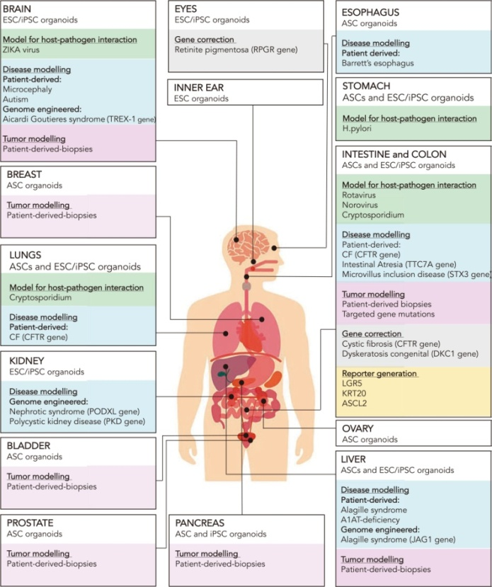
类器官研究-相关细胞因子
BRAIN
EYES
ESOPHAGUS
Brain | Breast | Lung | Prostate | Pancreatic | Heart | Intestinal | Gastric | Liver
 | EGF |  | EGF | EGF |  | EGF | EGF | EGF
FGF2 | FGF2 | FGF2 | FGF2 | FGF2 | FGF2 |  |  | FGF2
 |  | FGF7
 |  |  |  |  |  |  |  | TGFB1
 | FGF10 | FGF10 | FGF10 | FGF10 | FGF10 |  | FGF10 | FGF10
NOG | NOG | NOG | NOG | NOG |  | NOG | NOG | NOG
 |  | INHBA | INHBA |  | INHBA |  |  | INHBA
 |  |  |  |  |  |  |  | HGF
 | RSPO1 | RSPO1 | RSPO1 | RSPO1 |  | RSPO1 | RSPO1 | RSPO1
 |  |  |  |  |  |  |  | OSM
DKK1 |  |  |  |  |  |  |  | DKK1
GDNF
 |  |  |  |  | LIF
INNER EAR
STOMACH
INTESTINE and COLON
BREAST
LUNGS
KIDNEY
OVARY
BLADDER
LIVER
PROSTATE
PANCREAS
Figure. Human-derived organoids
Benedetta Artegiani; et al. doi.org/10.1093/hmg/ddy187.
义翘神州

Slide 20
03
经类器官培养验证的细胞因子
义翘神州

Slide 21
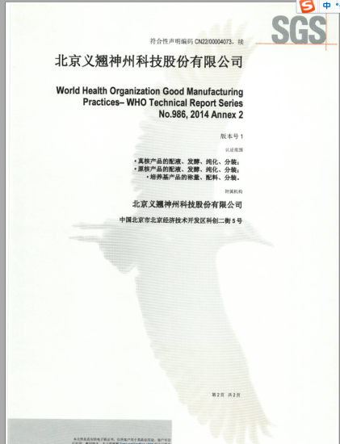

细胞因子产品线特点概述
250+细胞因子类分子，800+细胞因子类产品
按照ISO9001:2015和ISO13485:2016质量管理体系要求进行生产
涉及免疫细胞培养、干细胞研究、类器官培养等热门应用领域
覆盖生长因子、趋化因子、干扰素、白介素、淋巴因子等
严格质控造就更优细胞活性
高批间一致性
高纯度
（20+GMP级细胞因子）
GMP认证书
2024年值得关注的生长因子供应商
义翘神州

Slide 22
细胞因子产品设计
种属多：Human、Mouse、Monkey等，尽可能满足不同的动物实验模型
倾向于无标签或者小标签
真核或者原核表达系统
低内毒素
活性有竞争力
应用场景数据展示
义翘神州

Slide 23
细胞因子产品设计
多种属：Human、Mouse、Monkey等，尽可能满足不同的动物实验模型的需求
用于小肠隐窝分离和类器官培养
小鼠小肠
Advanced DMEM/F12 medium
培养主要组成
50 ng/mL Mouse EGF (Sino Biological, 50482-MNCH)
隐窝富集
包埋在Matrigel中
接种到24孔板上
100 ng/mL Mouse Noggin (Sino Biological, 50688-M02H)
添加类器官培养基
每2天更换新鲜培养基
500 ng/mL Human R-spondin1 (Sino Biological, 11083-HNAS)
Yuanchuang Li; et al. doi.org/10.1016/j.stemcr.2020.12.005.
义翘神州

Slide 24
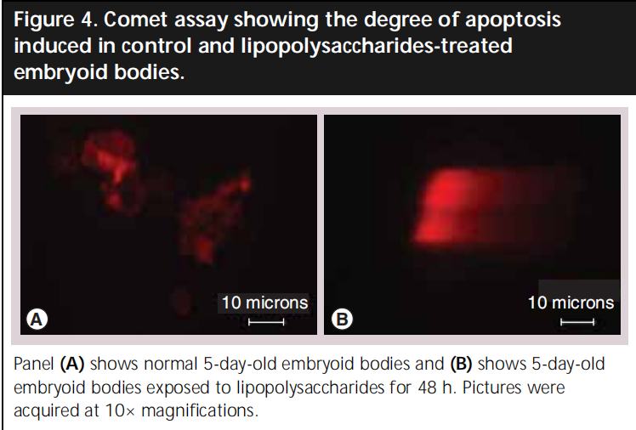
细胞因子产品设计
低内毒素
LPS处理的胚状体中胚层的生物标志物会消失且不能分化成有功能的成骨细胞
LPS处理的胚状体会出现凋亡的现象
Kavitha Sivasubramaniyan; et al. doi.org/10.2217/17460751.3.1.23.
义翘神州
Notes:
脂多糖
用胚状体作为体外模型去检验格兰仕阴性菌对于胚胎发生过程中胚系的诱导的影响
LPS (also termed endotoxin) is the major component of the outer membrane of Gram-negative bacteria：LPS（也称为内毒素）是革兰氏阴性菌外膜的主要成分
成骨细胞

Slide 25
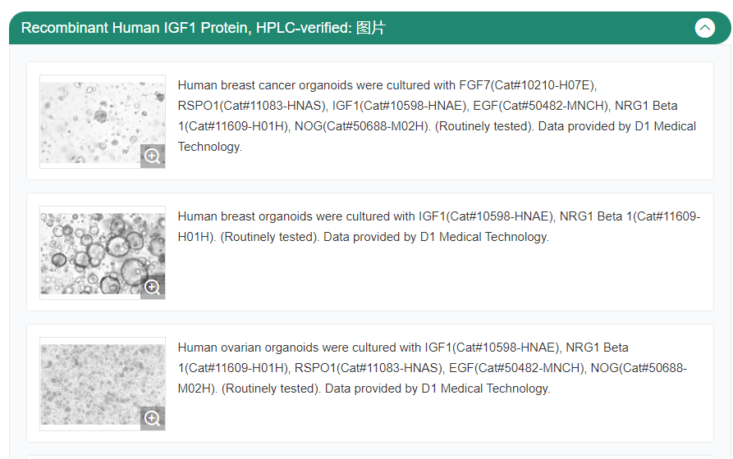
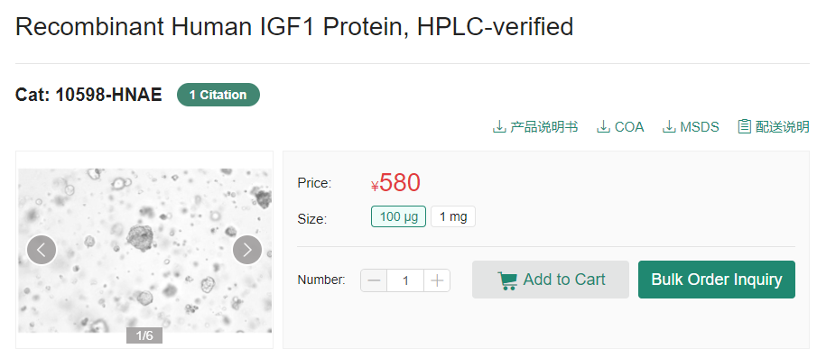
细胞因子产品设计
应用场景数据展示-1：类器官应用场景
点开产品详情页
产品详情页下拉
义翘神州

Slide 26
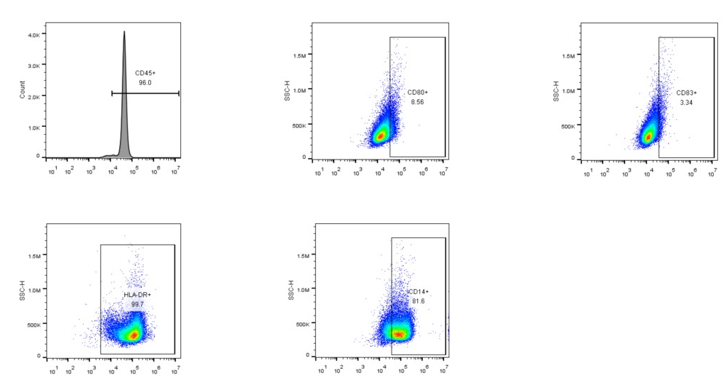
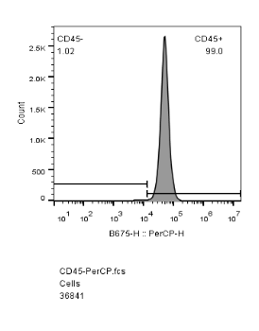
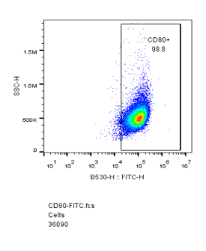
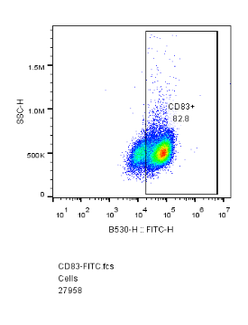
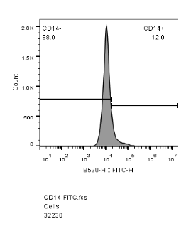
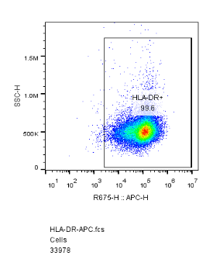
细胞因子产品设计
应用场景数据展示-2：免疫细胞应用场景
Immature DCs
Mature DCs
CD14+ monocytes were differentiated into immature DCs by GM-CSF(GMP-10015-HNAH) and IL4(GMP-11846-HNAE) for 6 days.
DCs were matured by TNF(GMP-10602-HNAE) for 2 days.
义翘神州

Slide 27
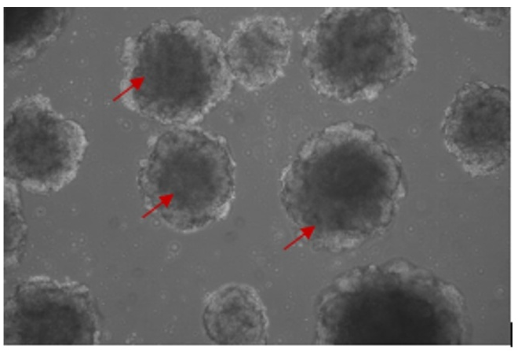
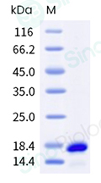
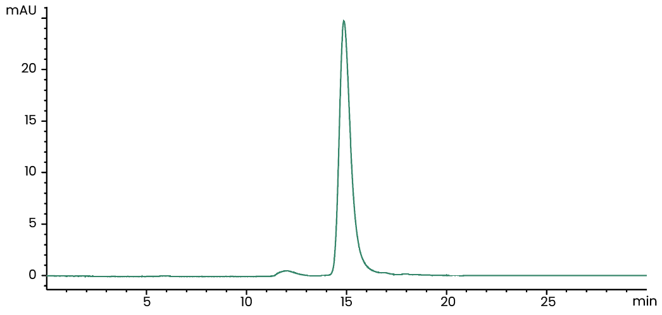
类器官培养相关产品数据
FGF2/bFGF 10014-HNAE
VEGF165 11066-HNAH
血管类器官培养
高纯度
高纯度
≥ 95 %
iPSC-derived human vascular organoids (Day 7) were cultured with FGF2(10014-HNAE), VEGF165(11066-HNAH), EGF(10605-HNAE). Red arrows represent vascular organoids. Image taken at 10x magnification.
≥ 95 %
义翘神州

Slide 28
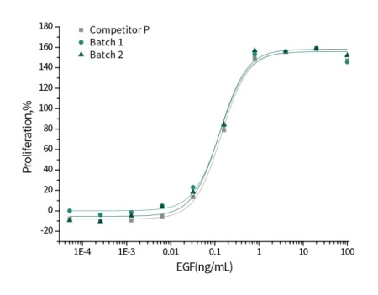
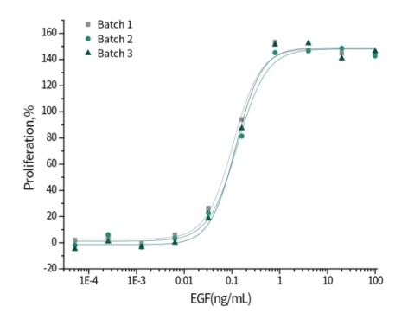
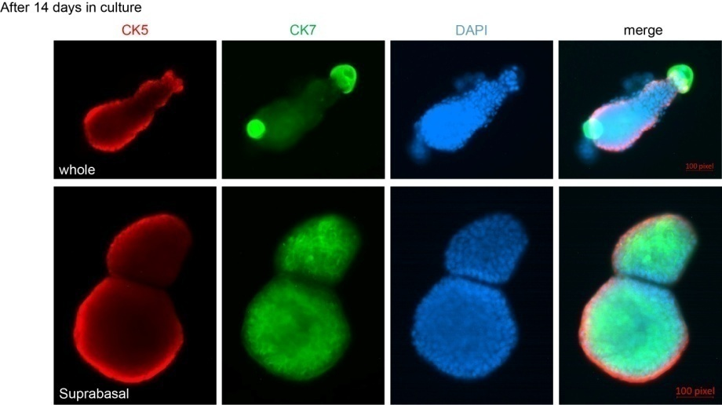
类器官培养相关产品数据
EGF 10605-HNAE
KGF/FGF-7 50394-M07E
小鼠膀胱类器官培养
活性比较数据
批间一致性数据
经过14天的培养
国外知名品牌
义翘神州批次1
义翘神州批次2
国外知名品牌
义翘批次1
义翘批次2
义翘神州批次1
义翘神州批次2
义翘神州批次3
Measured in a cell proliferation assay using Balb/C3T3 mouse embryonic fibroblasts.
Mouse Bladder Organoids after 14 days in culture 25 ng/mL of Recombinant Mouse KGF/FGF-7 Protein(50394-M07E) was used for 2 weeks in BME submerged in mouse bladder media. Data provided by Dr. Yin at Washington University, St. Louis, MO.
义翘神州

Slide 29
肠道类器官培养-文献中产品应用案例 1
肠道类器官
肠损失后的肠道再生
Advanced DMEM/F12 medium
小鼠小肠
培养主要组成
50 ng/mL Mouse EGF (Sino Biological, 50482-MNCH)
隐窝富集
包埋在Matrigel中
接种到24孔板上
100 ng/mL Mouse Noggin (Sino Biological, 50688-M02H)
500 ng/mL Human R-spondin1 (Sino Biological, 11083-HNAS)
添加类器官培养基
每2天更换新鲜培养基
Yuanchuang Li; et al. doi.org/10.1016/j.stemcr.2020.12.005.
义翘神州

Slide 30
肠道类器官培养-文献中产品应用案例 2
结直肠癌类器官
结直肠癌患者耐药性的研究
结直肠癌组织分离
原代培养
Advanced DMEM/F12 medium
包埋在Matrigel中
接种到24孔板上
培养主要组成
50 ng/mL Mouse EGF (Sino Biological, 50482-MNCH)
添加类器官培养基
每3天更换新鲜培养基
100 ng/mL Mouse Noggin (Sino Biological, 50688-M02H)
500 ng/mL Human R-spondin1 (Sino Biological, 11083-HNAS)
结直肠癌类器官用于：
药敏试验
转录组测序
Lifeng Chen; et al. doi.org/10.3389/fonc.2022.855674.
义翘神州

Slide 31
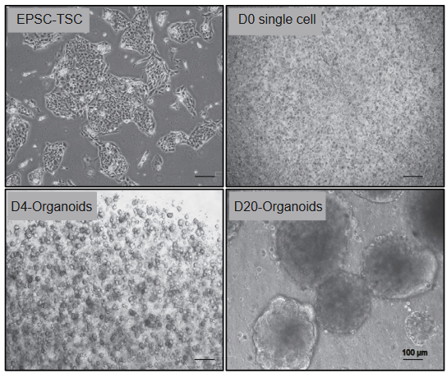
其他类器官培养-文献中产品应用案例
滋养层类器官
80 ng/mL Human R-spondin 1 (Sino Biological, 11083-HNAS)
培养中用到的细胞因子
50 ng/mL Human HGF (Sino Biological, 10463-HNAS)
50 ng/mL Human EGF
100 ng/mL Human FGF2
扩增潜力干细胞-滋养层干细胞来源的滋养层类器官
Degong Ruan; et al. doi.org/10.1016/j.xcrm.2022.100849.
义翘神州

Slide 32
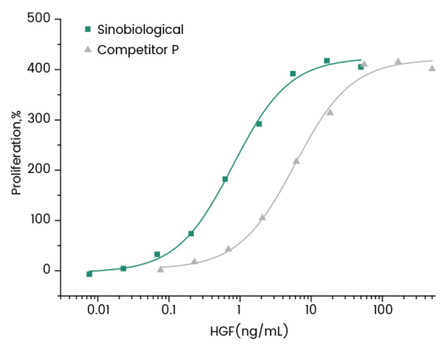
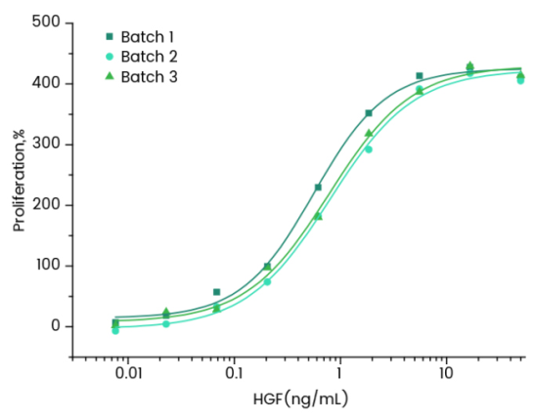
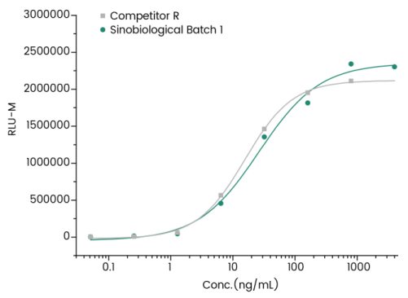
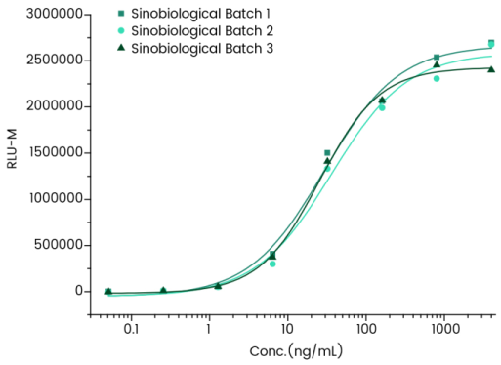
类器官培养相关产品数据
RSPO1 11083-HNAS
HGF 10463-HNAS
活性比较数据
批间一致性数据
活性比较数据
批间一致性数据
义翘神州批次1
义翘神州批次2
义翘神州批次3
义翘神州
国外知名品牌
义翘神州批次1
义翘神州批次2
义翘神州批次3
国外知名品牌
义翘神州
Measured by its ability to induce activation of ßcatenin response in a Topflash Luciferase assay using HEK293T human embryonic kidney cells.
Measured by its ability to neutralize TGF-beta mediated inhibition on Mv-1-Lu cell proliferation.
义翘神州

Slide 33
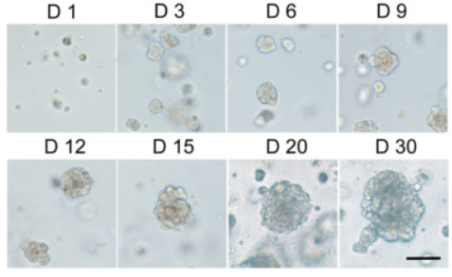
脑类器官培养-文献中产品应用案例 1
脑肿瘤类器官
培养中用到的细胞因子
10 ng/mL Human FGF10 (Sino Biological, 10573-HNAE)
10 ng/mL Human EGF (Sino Biological, 10605-HNAE)
不同时间点颅咽管瘤类器官的形态
Xiao-Yan Tang; et al. doi.org/10.1038/s41392-022-01024-9.
义翘神州

Slide 34
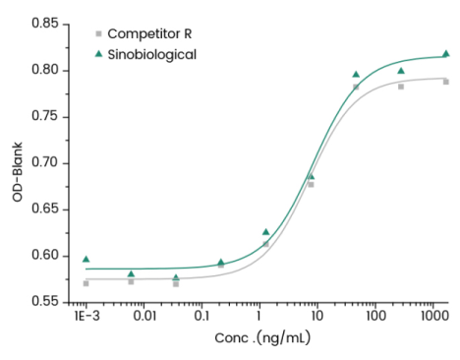
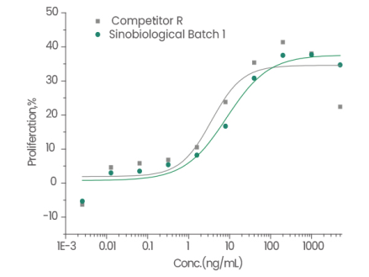
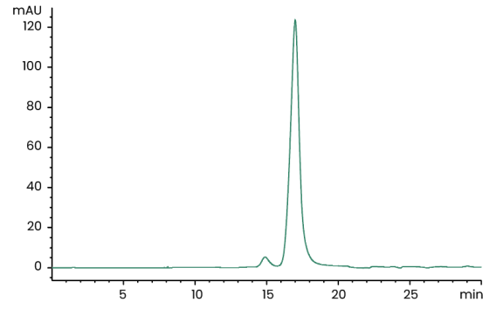
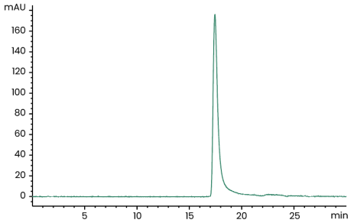
类器官培养相关产品数据
FGF7/KGF 10210-H07E
FGF10 10573-HNAE
活性比较数据
活性比较数据
国外知名品牌
义翘神州
国外知名品牌
义翘神州
≥ 95 %
≥ 95 %
Cell proliferation assay using BaF3 mouse pro-B cells transfected with human FGFR2b.
Cell proliferation assay using BaF3 mouse pro-B cells transfected with human FGFR2b.
义翘神州

Slide 35
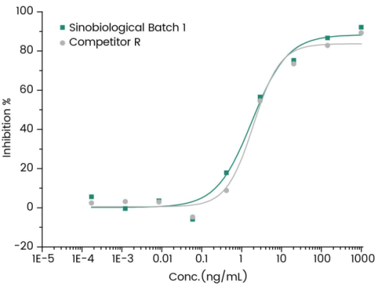
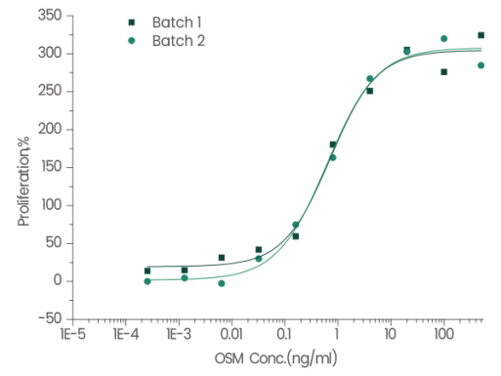
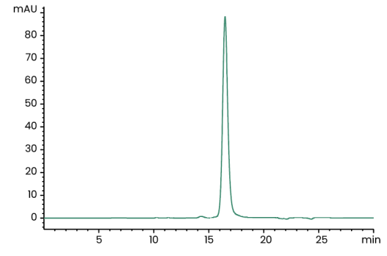
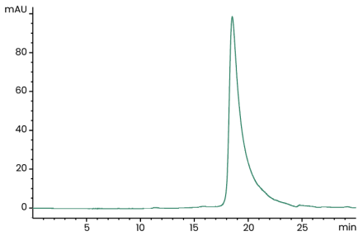
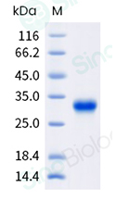
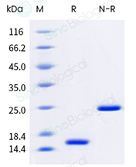
类器官培养相关产品数据
GMP级 Human Activin A
GMP-10429-HNAH
GMP级 Human OSM
GMP-10452-HNAH
活性比较数据
批间一致性数据
义翘神州
国外知名品牌
义翘神州批次1
义翘神州批次2
Inhibit proliferation of MPC-11 cells. >1000U/mg
≥ 95 %
Cell proliferation assay using TF-1 human erythroleukemic cells.
>30,000 Units/μg
≥ 95 %
义翘神州

Slide 36
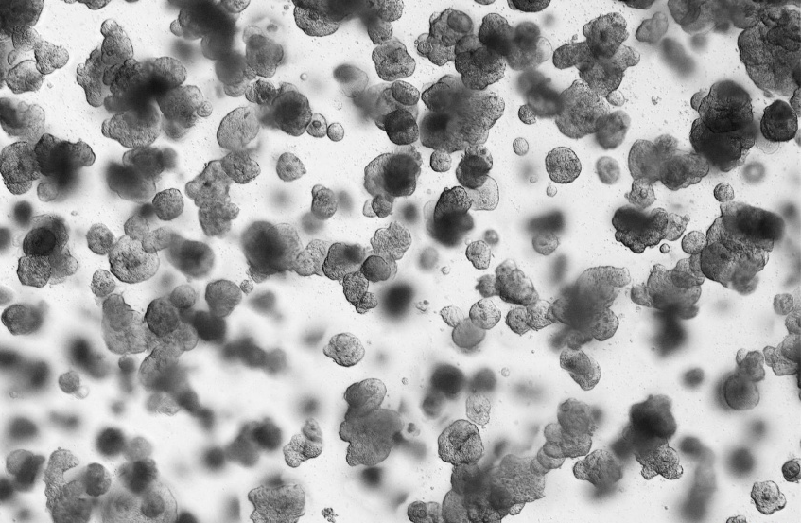
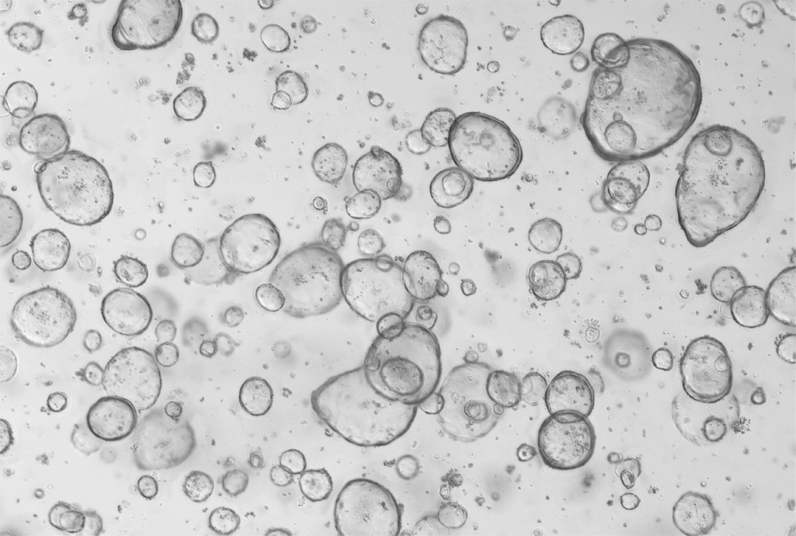
经不同类器官培养验证的细胞因子
人肠癌类器官
人结直肠类器官
Human intestinal cancer organoids were cultured with RSPO1(11083-HNAS), EGF(50482-MNCH), NOG(50688-M02H). (Routinely tested). Data provided by D1 Medical Technology
Human colorectum organoids were cultured with RSPO1(11083-HNAS), EGF(50482-MNCH), NOG(50688-M02H). (Routinely tested). Data provided by D1 Medical Technology.
义翘神州

Slide 37
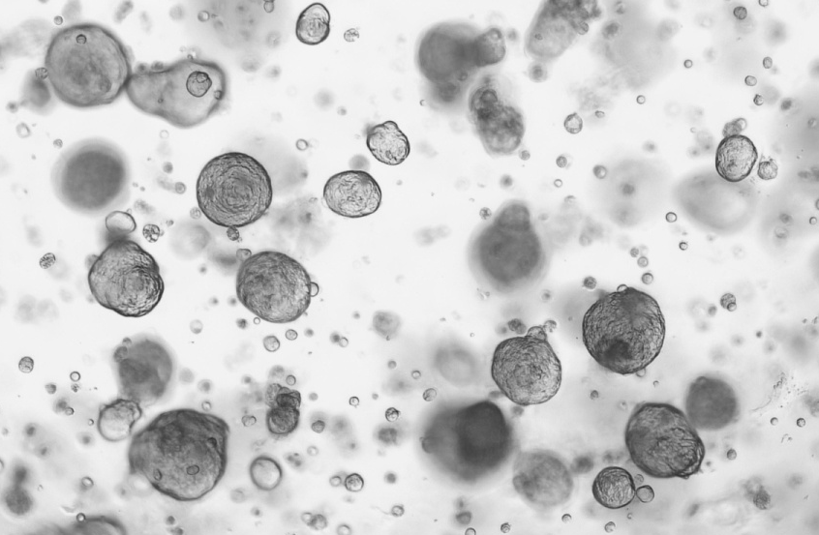
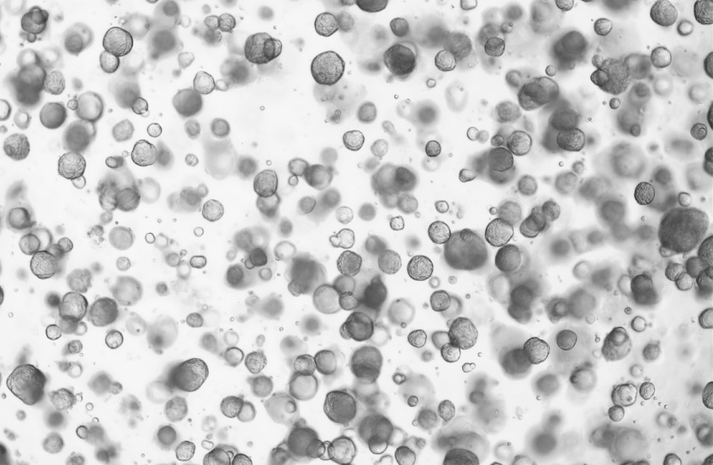
经不同类器官培养验证的细胞因子
人肺癌类器官
人肺类器官
Human lung cancer organoids were cultured with FGF2(10014-HNAE), FGF4(16043-HNAE), FGF7(10210-H07E), EGF(50482-MNCH), FGF10(10573-HNAE), NOG(50688-M02H), RSPO1(11083-HNAS). (Routinely tested). Data provided by D1 Medical Technology.
Human lung organoids were cultured with FGF2(10014-HNAE), FGF4(16043-HNAE), FGF7(10210-H07E), EGF(50482-MNCH), FGF10(10573-HNAE), NOG(50688-M02H), RSPO1(11083-HNAS). (Routinely tested). Data provided by D1 Medical Technology.
义翘神州

Slide 38
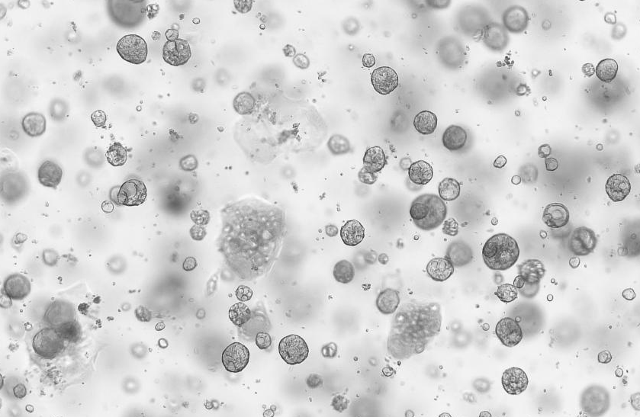
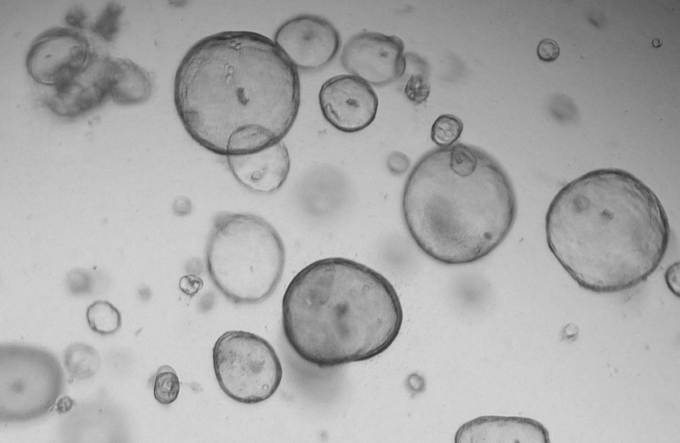
经不同类器官培养验证的细胞因子
人肝癌类器官
人胆管癌类器官
Human liver cancer organoids were cultured with FGF2(10014-HNAE), HGF(10463-HNAS), FGF7(10210-H07E), EGF(50482-MNCH), FGF10(10573-HNAE), TGFB1(10804-HNAC), NOG(50688-M02H), RSPO1(11083-HNAS). (Routinely tested). Data provided by D1 Medical Technology.
Human cholangiocarcinomas organoids were cultured with FGF2(10014-HNAE), HGF(10463-HNAS), FGF7(10210-H07E), EGF(50482-MNCH), FGF10(10573-HNAE), NOG(50688-M02H), RSPO1(11083-HNAS). (Routinely tested). Data provided by D1 Medical Technology.
义翘神州

Slide 39
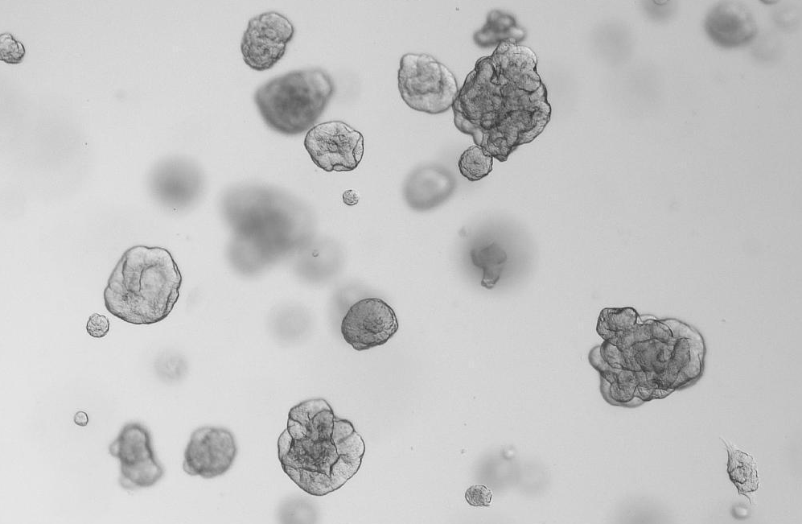
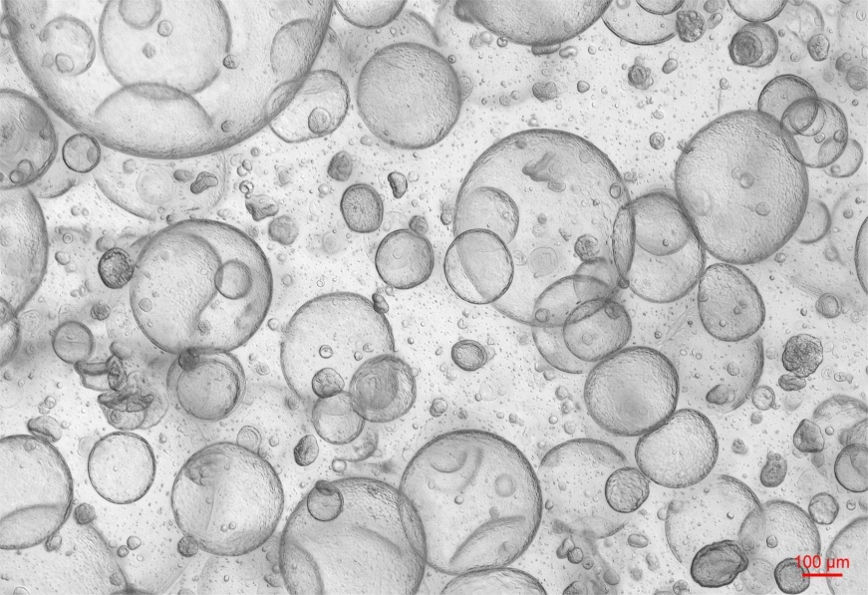
经不同类器官培养验证的细胞因子
人肾癌类器官
人肾类器官
Human kidney cancer organoids were cultured with FGF2(10014-HNAE), FGF7(10210-H07E), EGF(50482-MNCH), FGF10(10573-HNAE), NOG(50688-M02H), RSPO1(11083-HNAS). (Routinely tested). Data provided by D1 Medical Technology.
Human kidney organoids were cultured with FGF7(10210-H07E), EGF(50482-MNCH), FGF10(10573-HNAE), NOG(50688-M02H), RSPO1(11083-HNAS), HGF(10463-HNAS), FGF4(16043-HNAE). (Routinely tested). Data provided by D1 Medical Technology.
义翘神州

Slide 40
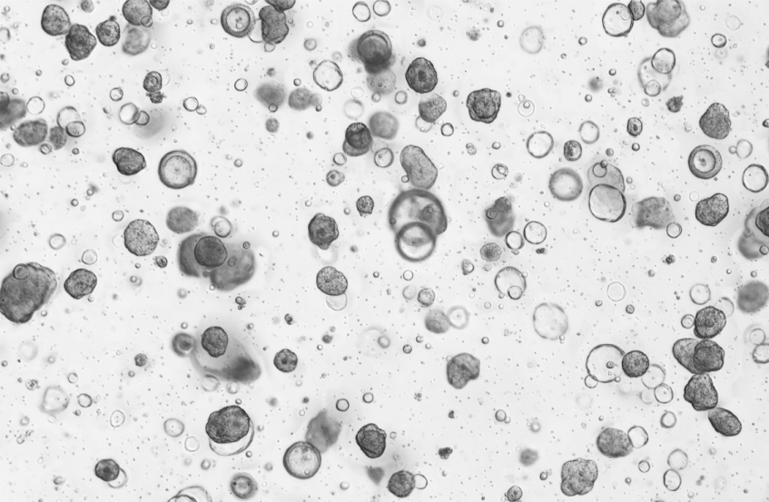
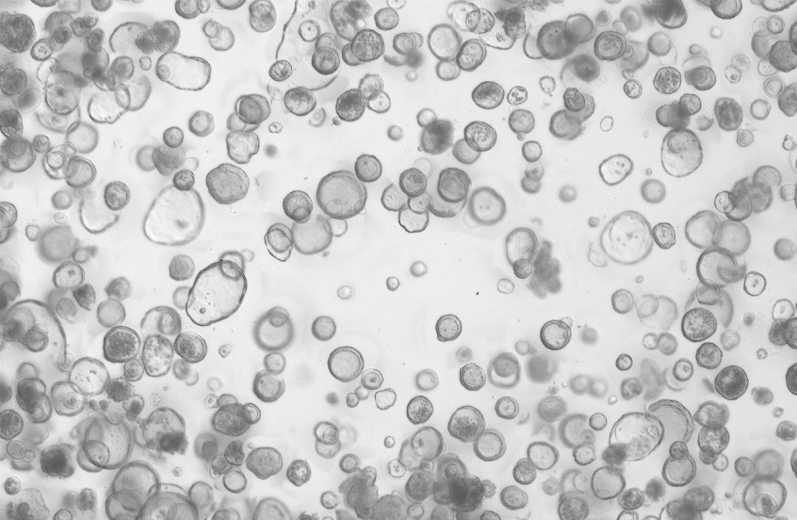
经不同类器官培养验证的细胞因子
人胃癌类器官
人胃类器官
Human gastric cancer organoids were cultured with EGF(50482-MNCH), FGF10(10573-HNAE), NOG(50688-M02H), RSPO1(11083-HNAS). (Routinely tested). Data provided by D1 Medical Technology
Human stomach organoids organoids were cultured with EGF(50482-MNCH), FGF10(10573-HNAE), NOG(50688-M02H), RSPO1(11083-HNAS). (Routinely tested). Data provided by D1 Medical Technology.
义翘神州

Slide 41


经不同类器官培养验证的细胞因子
人卵巢癌类器官
人小肠类器官
Human ovarian organoids were cultured with IGF1(10598-HNAE), NRG1 Beta 1(11609-H01H), RSPO1(11083-HNAS), EGF(50482-MNCH), NOG(50688-M02H). (Routinely tested). Data provided by D1 Medical Technology.
Human small intestinal organoids were cultured with IL22(13059-HNAE), FGF10(10573-HNAE), EGF(50482-MNCH), NOG(50688-M02H). (Routinely tested). Data provided by D1 Medical Technology.
义翘神州

Slide 42
类器官培养相关细胞因子产品(部分)
货号 | 分子 | Intestinal | Gastric | Liver | Lung | Breast | Brain | Heart | Pancreatic | Prostate
10605-HNAE | EGF | ✓ | ✓ | ✓ |  | ✓ |  |  | ✓ | ✓
10014-HNAE | FGF2 |  |  | ✓ | ✓ | ✓ | ✓ | ✓ | ✓ | ✓
10210-H07E | FGF7 |  |  |  | ✓
10804-HNAC | TGFB1 |  |  | ✓
10573-HNAE | FGF10 |  | ✓ | ✓ | ✓ | ✓ |  | ✓ | ✓ | ✓
10267-HNAH | NOG | ✓ | ✓ | ✓ | ✓ | ✓ | ✓ |  | ✓ | ✓
10429-HNAH | INHBA |  |  | ✓ | ✓ |  |  | ✓ |  | ✓
10463-HNAS | HGF |  |  | ✓
11083-HNAS | RSPO1 | ✓ | ✓ | ✓ | ✓ | ✓ |  |  | ✓ | ✓
10452-HNAH | OSM |  |  | ✓
10170-H08H | DKK1 |  |  | ✓ |  |  | ✓
10561-HNAE | GDNF |  |  |  |  |  | ✓
14890-HNAH | LIF |  |  |  |  |  |  | ✓
16043-HNAE | FGF4 |  |  |  |  |  | ✓
10609-HNAE2 | BMP4 |  |  |  |  |  | ✓
义翘神州

Slide 43









关于“北京义翘神州”
坚持自主研发生产
打造中国生命科学研究“一站式”试剂与服务支撑平台
现货供应
6,900 +
重组蛋白
14,000 +
精品抗体
49,000+
基因产品
ELISA 试剂盒、培养基、
GMP级核酸酶等特色产品
人才与设施
荣誉资质
设施：
---26,000+平米研发中心
--- 7,000平米洁净车间
团队：近1000人
--- 硕士以上学历占1/3
--- 10+ 欧美深造经历
义翘神州
Notes:
北京义翘神州科技股份有限公司，总部位于北京亦庄，是国家高新技术企业。目前已在美国、欧洲、日本，以及国内的泰州、苏州建立了子公司，在上海、广州成立分公司。公司目前建立有重组蛋白、抗体、基因产品库，以及ELISA试剂盒、培养基、转染试剂、GMP级核酸酶等产品的研发与生产，现货产品超过6.7万种。
同时，建立有从基因克隆、蛋白表达、抗体开发与生产到质量控制研究在内的一站式CRO技术服务平台，推进客户研发进程。

Slide 44

感谢观看！
北京义翘神州科技股份有限公司
地址：北京市经济技术开发区科创十街18号院9号楼
电话：400-890-9989
网址：cn.sinobiological.com
邮箱：order@Sinobiological.com
义翘神州

