Slide 1
Unit 9 Have you ever been to a museum?
Section B 2a-2e
R·八年级下册

Slide 2
Learning objects
By the end of the class, you will be able to …
1. Learn curriculum words and useful expressions.
2. Understand the main idea according to the key
words.
3. Train and improve the reading skills and know
something about Singapore.

Slide 3
Free talk
If you’re going to travel, what factors should you think about?
history
place to visit
best time to go and stay there
food
travel
people
weather
…
transportation

Slide 4
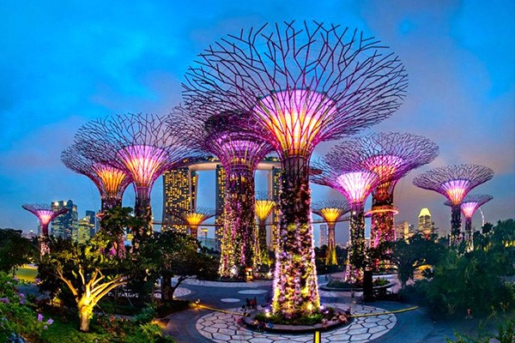
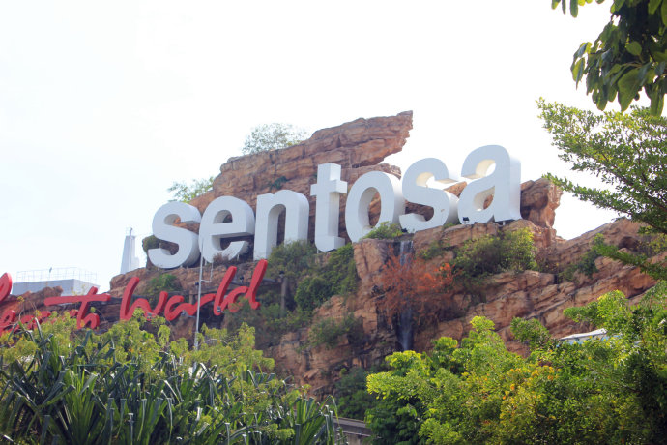
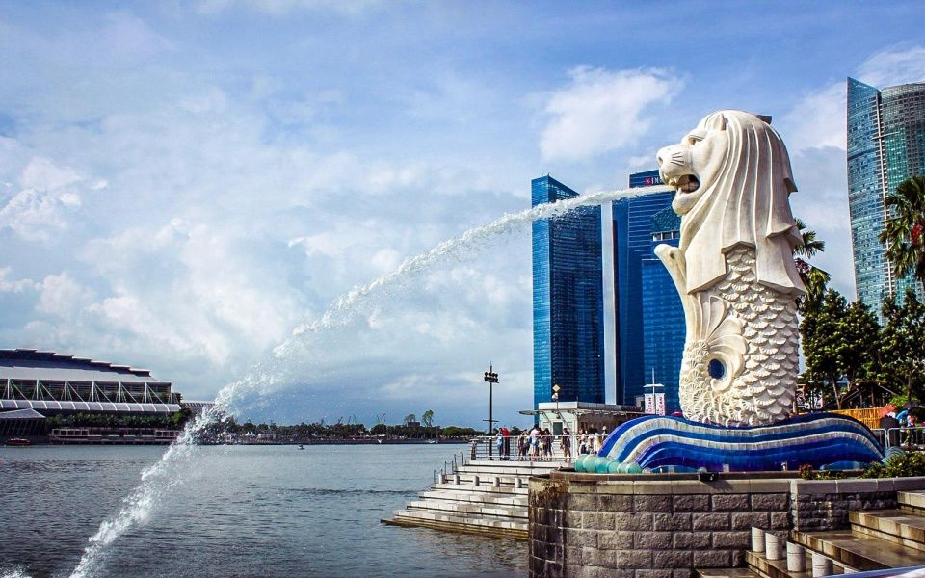
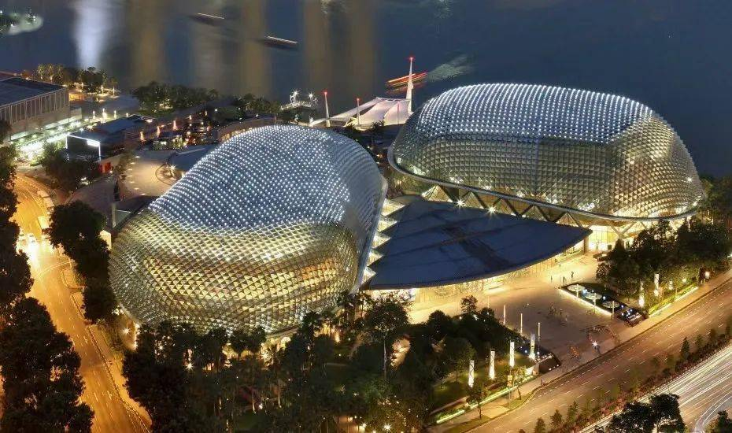
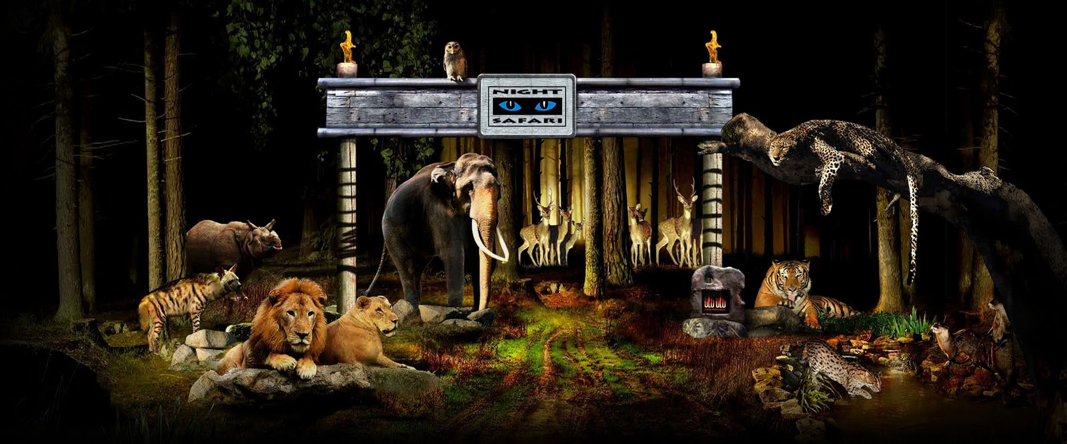
Brainstorm
Which country do they belong to?
Singapore.

Slide 5
What do you know or want to know about Singapore? Discuss it with your group.
2a
For example:
Where is Singapore?
How’s the weather in Singapore?
What’s the currency in Singapore?
Is Singapore an excellent place to travel?
…

Slide 6
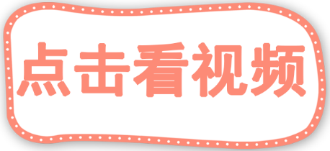
Do you know more about Singapore?

Slide 7
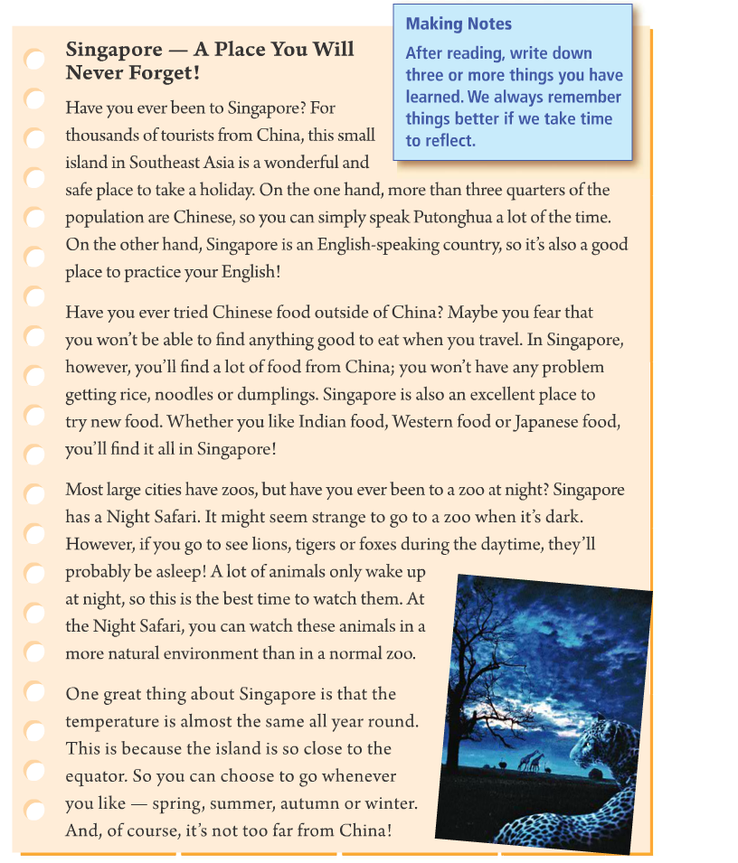

Fast reading
Task 1: Match the topic with each paragraph
Para. 1 temperature
Para. 2 zoo
Para. 3 food
Para. 4 language
Tip: Just read the specific information.

Slide 8
Explain the topic of each paragraph.
1. languages: ________ and ________
2. food: _______ food and ____ food, such as
______ food, ________ food, or ________ food
3. zoo: There is a ___________ that you can go
_______.
4. temperature: It’s almost ____________________.
Chinese
English
Chinese
new
Tip: The topic sentence may be in the first or last sentence.
Indian
Western
Japanese
Night Safari
at night
the same all year round

Slide 9
Task 2
Read the article. How many reasons can you find for visiting Singapore?
2b
Tip: You can underline the key sentences while reading.

Slide 10
I can find eight reasons for visiting Singapore.
1. a wonderful and safe place to take a holiday
2. can simply speak Putonghua a lot of the time
3. a good place to practice English
4. will find a lot of food from China
5. an excellent place to try new food
6. the Night Safari
7. the temperature is almost the same all year
round, so you can visit it at any time of the year
8. not too far from China

Slide 11
Careful reading
Task 1: Read Para. 1 and finish the tasks.
in Southeast Asia
Location: ____________________
more than three quarters of the population are Chinese
People: ________________________
________________________
Singapore
Putonghua and English
Language: _____________________

Slide 12
Why is Singapore a wonderful and safe place to take a holiday?
On the one hand, more than three quarters of the population are Chinese, so you can simply speak Putonghua a lot of the time. On the other hand, Singapore is an English-speaking country, so it’s also a good place to practice your English!

Slide 13

Task 2: Read Para. 2 and judge
1. You will have no problem getting rice, noodles
or dumplings in Singapore.
2. In Singapore, you can only find Chinese food.
3. Singapore is a good place to try new food.
Tip: Read carefully, especially pay attention to the details.

Slide 14
Task 3: Read Para. 3 and finish the task
1. Singapore has a special zoo called ___________.
2. A lot of animals only ________ at night, so this
is ____________ to watch them.
3. At the zoo, you can watch lions, tigers, and
foxes in a _______________________ than in a
normal zoo.
Night Safari
wake up
the best time
more natural environment

Slide 15

Task 4: Read Para. 4 and finish the task
1. How’s the weather in Singapore?
A. It’s very cold. B. It’s very hot.
C. The temperature is almost the same all year
round.
D. Sometimes cold and sometimes hot.

Slide 16
2. When is the best time to go to Singapore?
A. Spring and summer.
B. Summer and autumn.
C. Autumn and winter.
D. Whenever you like.

Slide 17

Singapore — A Place You Will Never Forget!
数以千计的；许许多多的
Have you ever been to Singapore? For thousands of tourists from China, this small island in Southeast Asia is a wonderful and safe place to take a holiday. On the one hand, more than three
quarters of the population are Chinese, so you can
安全的
动词不定式短语作后置定语
一方面

Slide 18
仅仅；只；只不过。相当于just, only
simply speak Putonghua a lot of the time. On the other hand, Singapore is an English-speaking country, so it’s also a good place to practice your English!
另一方面
English-speaking 说英语的
spoken English 英语口语
on the one hand… on the other hand… 常用来列举原因、情况等，说明一个事物的两个方面。

Slide 19
品尝；尝试
Have you ever tried Chinese food outside of China? Maybe you fear that you won’t be able
to find anything good to eat when you travel.
In Singapore, however, you’ll find a lot of food from China; you won’t have any problem
害怕；惧怕
that引导的宾语从句，作fear的宾语
不定式作定语修饰anything
when引导时间状语从句

Slide 20
getting rice, noodles or dumplings. Singapore is also an excellent place to try new food. Whether you like Indian food, Western food or Japanese food, you’ll find it all in Singapore!
whether可与or (not)连用，引导让步状语从句
印度的
日本的

Slide 21
Most large cities have zoos, but have you ever been to a zoo at night? Singapore has a Night Safari. It might seem strange to go to a zoo when it’s dark. However, if you go to see lions, tigers or foxes during the daytime, they’ll
狐狸

Slide 22
probably be asleep! A lot of animals only wake up at night, so this is the best time to watch them. At the Night Safari, you can watch these animals in a more natural environment than in a normal zoo.

Slide 23
主语 + 系动词
that引导的表语从句，that可省略
One great thing about Singapore is that the temperature is almost the same all year round. This is because the island is so close to the equator. So you can choose to go whenever you like — spring, summer, autumn or winter. And, of course, it’s not too far from China!
全年
在任何……的时候；无论何时
赤道
春天

Slide 24
The statements below are false. Use information from the article to correct them.
2c
1. Most people in Singapore only speak English.
2. It is not easy to get many different kinds of
good food in Singapore.
speak both English and Chinese
It’s easy

Slide 25
3. It is better to see lions and tigers during
the daytime because they will probably be
awake.
4. It is best to visit Singapore in the autumn.
at night
You can visit Singapore all year round.

Slide 26
Fill in the conversation about Singapore using the information from the article.
2d
A: I’m going to Singapore next week. _____
you ever _____ there before?
B: Yes, I’ve _____ to Singapore many times.
It’s my favorite country to visit in
_________ Asia.
Have
been
been
Southeast

Slide 27
A: What languages do people ______ there?
B: Mostly Chinese and _______.
A: What about the food? Is it good?
B: It’s excellent! ______ you ever tried
Indian food? Indian food is really good
in Singapore.
speak
English
Have

Slide 28
A: I see. Have you ____ heard of the Night
Safari? Someone told me to go there.
B: Yes! I ____ been to the Night Safari. It was
really exciting to ____ the animals in the dark.
A: And is it always _____ in Singapore?
B: All _____ round! It’s always summer there!
ever
have
see
hot
year

Slide 29
Make notes about Singapore. Write down anything that you remember. Do not look at the article.
2e
_________________________________________________________________________________________________________________________________________________________________________________________
Making Notes
After reading, write down three or more things you have learned. We always remember things better if we take time to reflect.

Slide 30
Let’s retell the passage
Singapore — A Place You Will Never Forget!
Location: in Southeast Asia
Para. 1
People: more than three quarters of the population are Chinese.
Language: Putonghua, English
Para. 2
Food
Chinese food, Indian food, Western food, Japanese food
the Night Safari, during the daytime, be asleep, wake up at night
Watch these animals in a more natural environment
Para. 3
Zoo
Temperature: almost the same all year round, close to the equator
Para. 4
Time to visit: whenever you like

Slide 31
Summary
Words and phrases:
thousand safe simply fear
whether Indian Japanese fox
whenever spring mostly

Slide 32
在东南亚 in Southeast Asia
度假胜地 a wonderful place to take a holiday
四分之三的人口 three quarters of population
做某事有困难 have problems doing sth.
在白天 during the daytime
睡醒 wake up
处于一个自然环境中 in a natural environment
全年 all year round

Slide 33
Homework
Read the passage again and recite the words and phrases.
Make a mind map to introduce the place you have visited.
Do the exercises.（见“状元成才路”系列丛书《创优作业》对应课时作业）

